Slide 1
Conditional Probability
CCM2 Unit 6: Probability

Slide 2
Conditional Probability
Conditional Probability: A probability where a certain prerequisite condition has already been met.
For example:
    What is the probability of selecting a queen given an ace has been drawn and not replaced.
    What is the probability that a student in the 10th grade is enrolled in biology given that the student is enrolled in CCM2?
Video about Conditional Probability

Slide 3
Conditional Probability Formula
The conditional probability of A given B is expressed as P(A | B)
P(A | B) = P(A and B)
P(B)

Slide 4
Joint Probability
P(A and B)
A
B
S

Slide 5
Conditional Probability
Since Event A has happened, the sample space is reduced to the outcomes in A
A
P(A and B) represents the outcomes from B that are included in A
S

Slide 6
Examples
You are playing a game of cards where the winner is determined by drawing two cards of the same suit. What is the probability of drawing clubs on the second draw if the first card drawn is a club?
P(club|club)
= P(2nd club and 1st club)/P(1st club)
= (13/52 x 12/51)/(13/52)
= 12/51 or 4/17
The probability of drawing a club on the second draw given the first card is a club is 4/17 or 23.5%

Slide 7
2. A bag contains 6 blue marbles and 2 brown marbles. One marble is randomly drawn and discarded. Then a second marble is drawn. Find the probability that the second marble is brown given that the first marble drawn was blue.
P(brown|blue)
= P(brown and blue)/P(blue)
= (6/8 x 2/7)/(6/8)
= 2/7
The probability of drawing a brown marble given the first marble was blue is 2/7 or 28.6%

Slide 8
3. In Mr. Jonas' homeroom, 70% of the students have brown hair, 25% have brown eyes, and 5% have both brown hair and brown eyes. A student is excused early to go to a doctor's appointment. If the student has brown hair, what is the probability that the student also has brown eyes?
P(brown eyes|brown hair)
= P(brown eyes and brown hair)/P(brown hair)
= .05/.7
= .071
The probability of a student having brown eyes given he or she has brown hair is 7.1%

Slide 9
Using Two-Way Frequency Tables to Compute Conditional Probabilities
In CCM1 you learned how to put data in a two-way frequency table (using counts) or a two-way relative frequency table (using percents), and use the tables to find joint and marginal frequencies and conditional probabilities.
Let’s look at some examples to review this.

Slide 10
1. Suppose we survey all the students at school and ask them how they get to school and also what grade they are in. The chart below gives the results. Complete the two-way frequency table:
 | Bus | Walk | Car | Other | Total
9th or 10th | 106 | 30 | 70 | 4
11th or 12th | 41 | 58 | 184 | 7
Total

Slide 11
 | Bus | Walk | Car | Other | Total
9th or 10th | 106 | 30 | 70 | 4 | 210
11th or 12th | 41 | 58 | 184 | 7 | 290
Total | 147 | 88 | 254 | 11 | 500
Suppose we randomly select one student.
a. What is the probability that the student walked to school?
    88/500
    17.6%
b. P(9th or 10th grader)
    210/500
    42%
c. P(rode the bus OR 11th or 12th grader)
    147/500 + 290/500 – 41/500
    396/500 or 79.2%

Slide 12
 | Bus | Walk | Car | Other | Total
9th or 10th | 106 | 30 | 70 | 4 | 210
11th or 12th | 41 | 58 | 184 | 7 | 290
Total | 147 | 88 | 254 | 11 | 500
d. What is the probability that a student is in 11th or 12th grade given that they rode in a car to school?
P(11th or 12th|car)
* We only want to look at the car column for this probability!
= 11th or 12th graders in cars/total in cars
= 184/254 or 72.4%
The probability that a person is in 11th or 12th grade given that they rode in a car is 72.4%

Slide 13
 | Bus | Walk | Car | Other | Total
9th or 10th | 106 | 30 | 70 | 4 | 210
11th or 12th | 41 | 58 | 184 | 7 | 290
Total | 147 | 88 | 254 | 11 | 500
e. What is P(Walk|9th or 10th grade)?
= walkers who are 9th or 10th / all 9th or 10th
= 30/210
= 1/7 or 14.2%
The probability that a person walks to school given he or she is in 9th or 10th grade is 14.2%

Slide 14
2. The manager of an ice cream shop is curious as to which customers are buying certain flavors of ice cream. He decides to track whether the customer is an adult or a child and whether they order vanilla ice cream or chocolate ice cream. He finds that of his 224 customers in one week that 146 ordered chocolate. He also finds that 52 of his 93 adult customers ordered vanilla. Build a two-way frequency table that tracks the type of customer and type of ice cream.
 | Vanilla | Chocolate | Total
Adult
Child
Total

Slide 15
 | Vanilla | Chocolate | Total
Adult | 52 |  | 93
Child
Total |  | 146 | 224
 | Vanilla | Chocolate | Total
Adult | 52 | 41 | 93
Child | 26 | 105 | 131
Total | 78 | 146 | 224
Find P(vanilla|adult)
= 52/93
= 55.9%
b. Find P(child|chocolate)
= 105/146
=71.9%

Slide 16
3. A survey asked students which types of music they listen to? Out of 200 students, 75 indicated pop music and 45 indicated country music with 22 of these students indicating they listened to both. Use a Venn diagram to find the probability that a randomly selected student listens to pop music given that they listen country music.
102
Pop
22
53
Country
23

Slide 17
102
Pop
22
53
Country
23
P(Pop|Country)
= 22/(22+23)
= 22/45 or 48.9%
48.9% of students who listen to country also listen to pop.

Slide 18
Using Conditional Probability to Determine if Events are Independent
If two events are statistically independent of each other, then:
P(A|B) = P(A) and P(B|A) = P(B)
Let’s revisit some previous examples and decide if the events are independent.

Slide 19
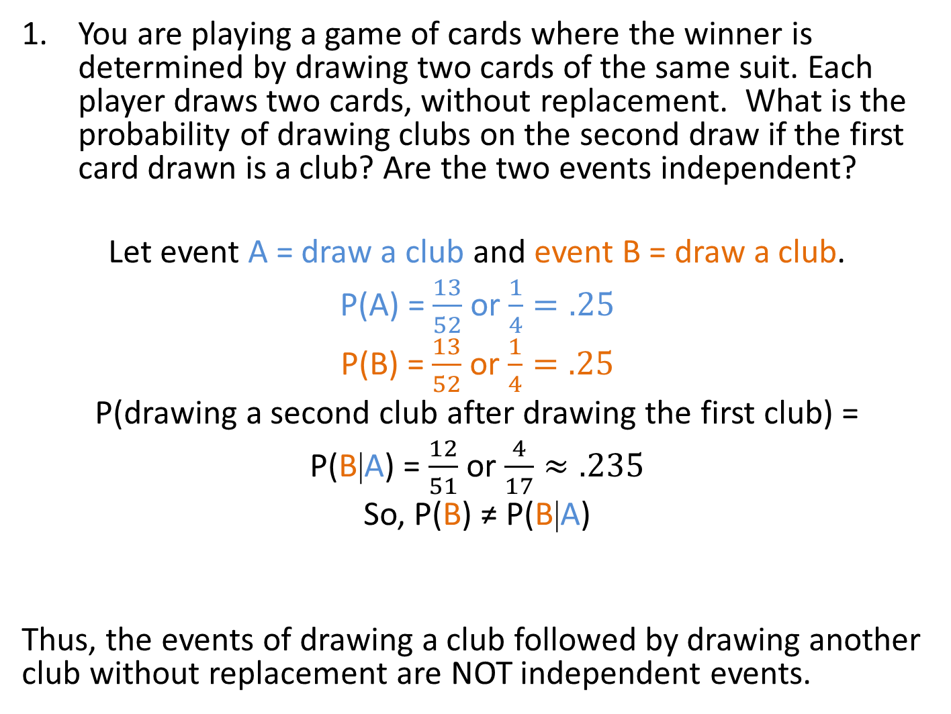
You are playing a game of cards where the winner is determined by drawing two cards of the same suit. Each player draws two cards, without replacement. What is the probability of drawing clubs on the second draw if the first card drawn is a club? Are the two events independent?
Let event A = draw a club and event B = draw a club.
P(A) = $\frac{13}{52}$ or $\frac{1}{4}=.25$
P(B) = $\frac{13}{52}$ or $\frac{1}{4}=.25$
P(drawing a second club after drawing the first club) =
P(B|A) = $\frac{12}{51}$ or $\frac{4}{17}≈.235$
So, P(B) ≠ P(B|A)
Thus, the events of drawing a club followed by drawing another club without replacement are NOT independent events.
13 clubs out of 52 cards
Only 12 clubs left and only 51 cards left
Notes:
Looking at it intuitively, B is dependent on A because once I draw a club, there are fewer clubs left in the deck, so the probability of getting another one is slightly less.

Slide 20
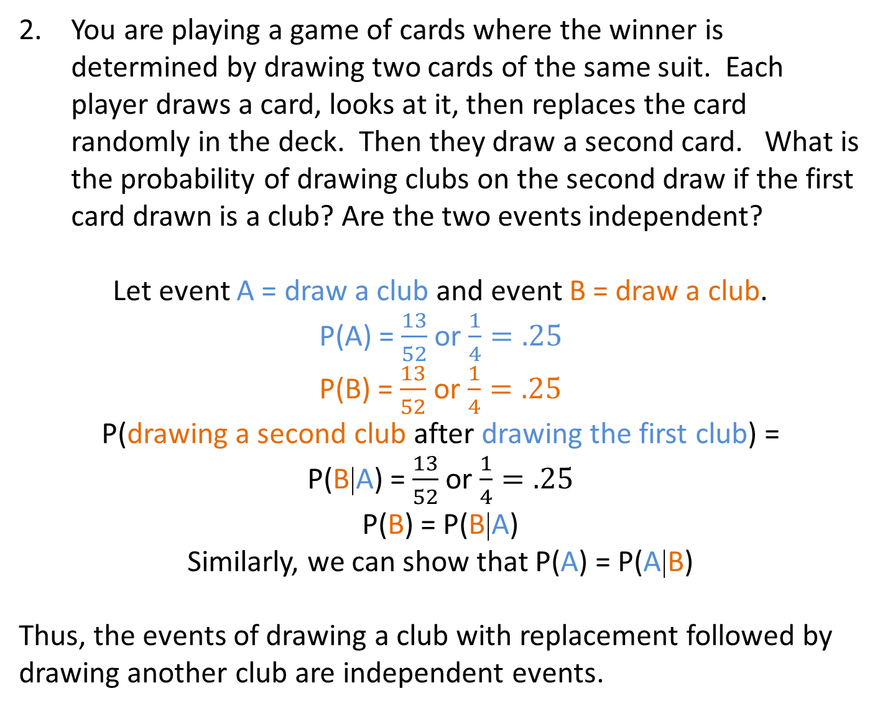
You are playing a game of cards where the winner is determined by drawing two cards of the same suit. Each player draws a card, looks at it, then replaces the card randomly in the deck. Then they draw a second card. What is the probability of drawing clubs on the second draw if the first card drawn is a club? Are the two events independent?
Let event A = draw a club and event B = draw a club.
P(A) = $\frac{13}{52}$ or $\frac{1}{4}=.25$
P(B) = $\frac{13}{52}$ or $\frac{1}{4}=.25$
P(drawing a second club after drawing the first club) =
P(B|A) = $\frac{13}{52}$ or $\frac{1}{4}=.25$
P(B) = P(B|A)
Similarly, we can show that P(A) = P(A|B)
Thus, the events of drawing a club with replacement followed by drawing another club are independent events.
13 clubs out of 52 cards
Still 13 clubs out of 52 cards
Notes:
Looking at it intuitively, B is independent of A because once I draw a club and replace it back in the deck, the probability of getting another one stays the same. It’s like starting over, so what happens with the second draw is not related to the first draw.

Slide 21
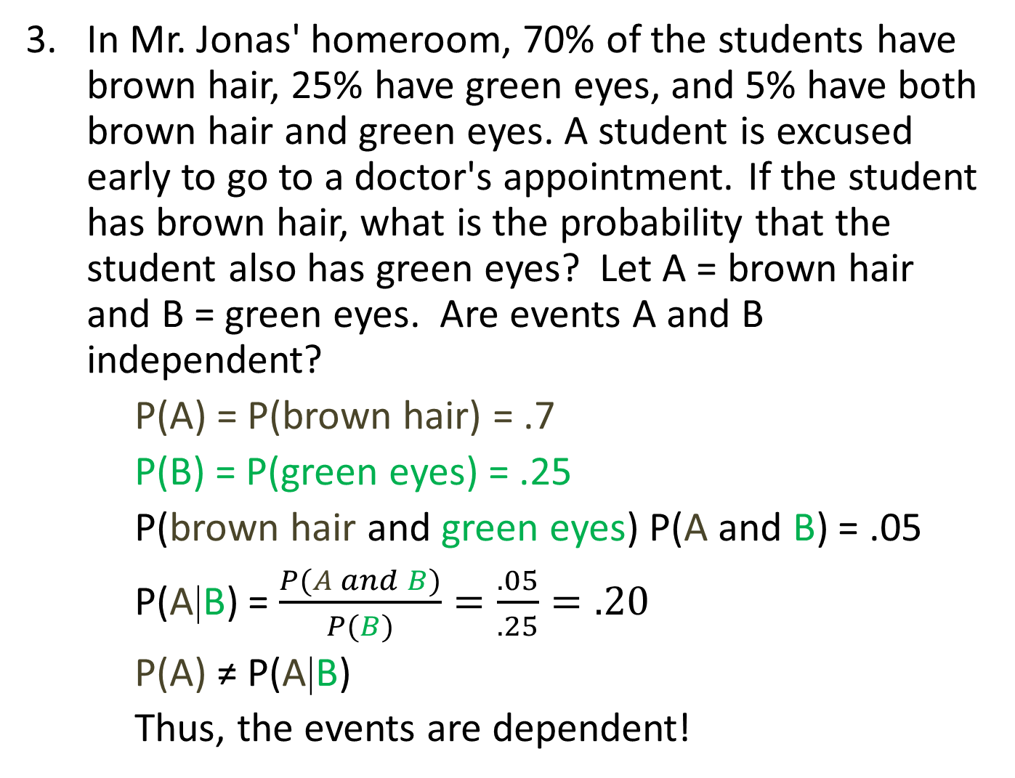
In Mr. Jonas' homeroom, 70% of the students have brown hair, 25% have green eyes, and 5% have both brown hair and green eyes. A student is excused early to go to a doctor's appointment. If the student has brown hair, what is the probability that the student also has green eyes? Let A = brown hair and B = green eyes. Are events A and B independent?
    P(A) = P(brown hair) = .7
    P(B) = P(green eyes) = .25
    P(brown hair and green eyes) P(A and B) = .05
    P(A|B) = $\frac{P(A and B)}{P(B)}=\frac{.05}{.25}=.20$
    P(A) ≠ P(A|B)
    Thus, the events are dependent!
This time we are using the formula for conditional probability
Notes:
Once we know that you have brown hair, the likelihood of you having green eyes goes up.

Slide 22
 | Vanilla | Chocolate | Total
Adult | 52 | 41 | 93
Child | 26 | 105 | 131
Total | 78 | 146 | 224
4. Determine whether age and choice of ice cream are independent events.
We could start by looking at the P(vanilla|adult) and P(vanilla). If they are the same, then the events are independent.
P(vanilla|adult) = 52/93 = 55.9%
P(vanilla) = 78/224 = 34.8%
P(vanilla|adult) ≠ P(vanilla), so the events are dependent!

