Slide 1
Permutations and
Combinations

Slide 2
Objectives:
apply fundamental counting principle
compute permutations
compute combinations
distinguish permutations vs combinations
find probabilities using permutations and combinations

Slide 3
Fundamental Counting Principle
Fundamental Counting Principle can be used determine the number of possible outcomes when there are two or more characteristics .
Fundamental Counting Principle states that if an event has m possible outcomes and another independent event has n possible outcomes, then there are m* n possible outcomes for the two events together.

Slide 4
Fundamental Counting Principle
Lets start with a simple example.
A student is to roll a die and flip a coin. How many possible outcomes will there be?
1H 2H 3H 4H 5H 6H
1T 2T 3T 4T 5T 6T
12 outcomes
6*2 = 12 outcomes

Slide 5
Fundamental Counting Principle
For a college interview, Robert has to choose what to wear from the following: 4 slacks, 3 shirts, 2 shoes and 5 ties. How many possible outfits does he have to choose from?
4*3*2*5 = 120 outfits

Slide 6
Permutations
A Permutation is an arrangement of items in a particular order.
Notice, ORDER MATTERS!
To find the number of Permutations of n items, we can use the Fundamental Counting Principle or factorial notation.

Slide 7
Permutations
The number of ways to arrange the letters ABC:
____ ____ ____
Number of choices for first blank?
3 ____ ____
Number of choices for second blank?
3 2 ___
Number of choices for third blank?
3 2 1
3*2*1 = 6 3! = 3*2*1 = 6
ABC ACB BAC BCA CAB CBA

Slide 8
Permutations
To find the number of Permutations of n items chosen r at a time, you can use the formula for finding P(n,r) or _{n}P_{r}

Slide 9
Permutations
Practice:
A combination lock will open when the right choice of three numbers (from 1 to 30, inclusive) is selected. How many different lock combinations are possible assuming no number is repeated?
Answer Now

Slide 10
Permutations
Practice:
A combination lock will open when the right choice of three numbers (from 1 to 30, inclusive) is selected. How many different lock combinations are possible assuming no number is repeated?

Slide 11

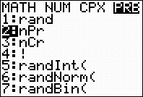
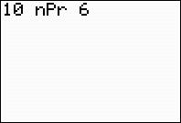
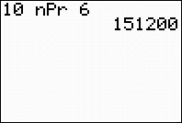
Permutations on the Calculator
You can use your calculator to find permutations
To find the number of permutations of 10 items taken 6 at a time (₁₀P₆):
Type the total number of items
Go to the MATH menu and arrow over to PRB
Choose option 2: nPr
Type the number of items you want to order

Slide 12
Permutations
Practice:
From a club of 24 members, a President, Vice President, Secretary, Treasurer and Historian are to be elected. In how many ways can the offices be filled?
Answer Now

Slide 13
Permutations
Practice:
From a club of 24 members, a President, Vice President, Secretary, Treasurer and Historian are to be elected. In how many ways can the offices be filled?

Slide 14
Combinations
A Combination is an arrangement of items in which order does not matter.
ORDER DOES NOT MATTER!
Since the order does not matter in combinations, there are fewer combinations than permutations. The combinations are a "subset" of the permutations.

Slide 15
Combinations
To find the number of Combinations of n items chosen r at a time, you can use the formula

Slide 16
Combinations
To find the number of Combinations of n items chosen r at a time, you can use the formula

Slide 17
Combinations
Practice:
To play a particular card game, each player is dealt five cards from a standard deck of 52 cards. How many different hands are possible?
Answer Now

Slide 18
Combinations
To play a particular card game, each player is dealt five cards from a standard deck of 52 cards. How many different hands are possible?
Practice:

Slide 19
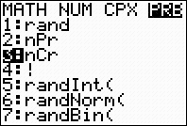
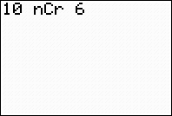
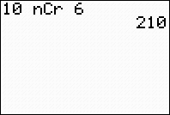
Combinations on the Calculator
You can use your calculator to find combinations
To find the number of combinations of 10 items taken 6 at a time (₁₀C₆):
Type the total number of items
Go to the MATH menu and arrow over to PRB
Choose option 3: nCr
Type the number of items you want to order

Slide 20
Combinations
Practice:
A student must answer 3 out of 5 essay questions on a test. In how many different ways can the student select the questions?
Answer Now

Slide 21
Combinations
A student must answer 3 out of 5 essay questions on a test. In how many different ways can the student select the questions?
Practice:

Slide 22
Combinations
Practice:
A basketball team consists of two centers, five forwards, and four guards. In how many ways can the coach select a starting line up of one center, two forwards, and two guards?
Answer Now

Slide 23
Combinations
Practice:
A basketball team consists of two centers, five forwards, and four guards. In how many ways can the coach select a starting line up of one center, two forwards, and two guards?
Center:
Forwards:
Guards:
Thus, the number of ways to select the starting line up is 2*10*6 = 120.

Slide 24
Probability with Permutations and Combinations
The 25-member senior class council is selecting officers for president, vice president and secretary. Emily would like to be president, David would like to be vice president, and Jenna would like to be secretary. If the offices are filled at random, beginning with president, what is the probability that they are selected for these offices?
Notes:
P(all three being selected) = 1/₂₅P₃ = 1/13,800

Slide 25
Probability with Permutations and Combinations
The 25-member senior class council is selecting members for the prom committee. Stephen, Marcus and Sabrina want would like to be on this committee. If the members are selected at random, what is the probability that all three are selected for this committee?
Notes:
P(all three being selected) = 1/₂₅C₃ = 1/2300

