Slide 1
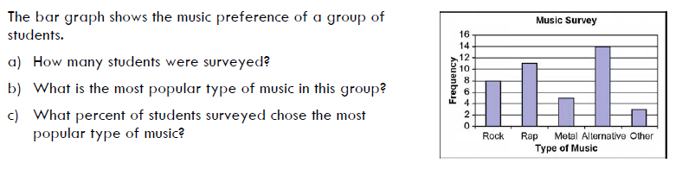
Warm Up
a) 41
b) Alternative
c) 14/41 = 34%

Slide 2
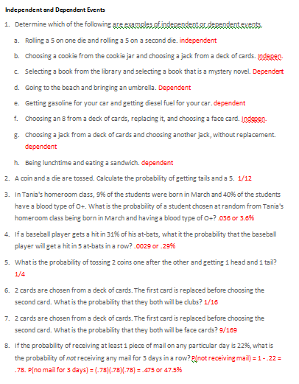
HW Check

Slide 3
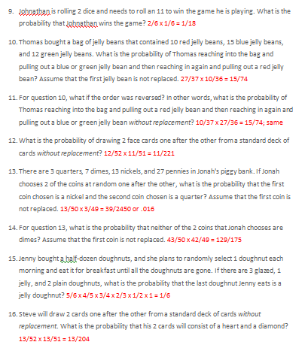
HW Check

Slide 4
Mutually Exclusive and Inclusive Events
OBJ: S-CP.7 Apply the Addition Rule, P(A or B) = P(A) + P(B) – P(A and B), and interpret the answer in terms of the model.

Slide 5
Mutually Exclusive Events
Suppose you are rolling a six-sided die. What is the probability that you roll an odd number or you roll a 2?
    Can these both occur at the same time?
    Why or why not?
Mutually Exclusive Events (or Disjoint Events): Two or more events that cannot occur at the same time.
The probability of two mutually exclusive events occurring at the same time , P(A and B), is 0!
Video on Mutually Exclusive Events
No
2 is not an odd number.

Slide 6
Probability of Mutually Exclusive Events
To find the probability of one of two mutually exclusive events occurring, use the following formula:
P(A or B) = P(A) + P(B)
or
P(A ∪ B) = P(A) + P(B)

Slide 7
Examples
If you randomly chose one of the integers 1 – 10, what is the probability of choosing either an odd number or an even number?
    Are these mutually exclusive events? Why or why not?
    Complete the following statement:
    P(odd or even) = P(_____) + P(_____)
    P(odd or even) = P(odd) + P(even)
    Now fill in with numbers:
    P(odd or even) = _______ + ________
    P(odd or even) = ½ + ½ = 1
Does this answer make sense?
YES!

Slide 8
2. Two fair dice are rolled. What is the probability of getting a sum less than 7 or a sum equal to 10?
Are these events mutually exclusive?
Sometimes using a table of outcomes is useful. Complete the following table using the sums of two dice:
Die | 1 | 2 | 3 | 4 | 5 | 6
1 | 2 | 3 | 4 | 5 | 6 | 7
2 | 3 | 4
3 | 4
4
5
6
Die | 1 | 2 | 3 | 4 | 5 | 6
1 | 2 | 3 | 4 | 5 | 6 | 7
2 | 3 | 4 | 5 | 6 | 7 | 8
3 | 4 | 5 | 6 | 7 | 8 | 9
4 | 5 | 6 | 7 | 8 | 9 | 10
5 | 6 | 7 | 8 | 9 | 10 | 11
6 | 7 | 8 | 9 | 10 | 11 | 12

Slide 9
Die | 1 | 2 | 3 | 4 | 5 | 6
1 | 2 | 3 | 4 | 5 | 6 | 7
2 | 3 | 4 | 5 | 6 | 7 | 8
3 | 4 | 5 | 6 | 7 | 8 | 9
4 | 5 | 6 | 7 | 8 | 9 | 10
5 | 6 | 7 | 8 | 9 | 10 | 11
6 | 7 | 8 | 9 | 10 | 11 | 12
P(getting a sum less than 7 OR sum of 10)
= P(sum less than 7) + P(sum of 10)
= 15/36 + 3/36
= 18/36
= ½
The probability of rolling a sum less than 7 or a sum of 10 is ½ or 50%.

Slide 10
Mutually Inclusive Events
Suppose you are rolling a six-sided die. What is the probability that you roll an odd number or a number less than 4?
    Can these both occur at the same time?
    If so, when?
Mutually Inclusive Events: Two events that can occur at the same time.
Video on Mutually Inclusive Events
Yes
When we roll a 1 or a 3.

Slide 11
Probability of the Union of Two Events: The Addition Rule
We just saw that the formula for finding the probability of two mutually inclusive events can also be used for mutually exclusive events, so let’s think of it as the formula for finding the probability of the union of two events or the Addition Rule:
P(A or B) = P(A ∪ B) = P(A) + P(B) – P(A ∩ B)
***Use this for both Mutually Exclusive and Inclusive events***

Slide 12
Examples
What is the probability of choosing a card from a deck of cards that is a club or a ten?
P(choosing a club or a ten)
= P(club) + P(ten) – P(10 of clubs)
= 13/52 + 4/52 – 1/52
= 16/52
= 4/13 or .308
The probability of choosing a club or a ten is 4/13 or 30.8%

Slide 13
2. What is the probability of choosing a number from 1 to 10 that is less than 5 or odd?
P(<5 or odd)
= P(<5) + P(odd) – P(<5 and odd)
<5 = {1,2,3,4} odd = {1,3,5,7,9}
= 4/10 + 5/10 – 2/10
= 7/10
The probability of choosing a number less than 5 or an odd number is 7/10 or 70%.

Slide 14
3. A bag contains 26 tiles with a letter on each, one tile for each letter of the alphabet. What is the probability of reaching into the bag and randomly choosing a tile with one of the first 10 letters of the alphabet on it or randomly choosing a tile with a vowel on it?
P(one of the first 10 letters or vowel)
= P(one of the first 10 letters) + P(vowel) – P(first 10 and vowel)
= 10/26 + 5/26 – 3/26
= 12/26 or 6/13
The probability of choosing either one of the first 10 letters or a vowel is 6/13 or 46.2%

Slide 15
4. A bag contains 26 tiles with a letter on each, one tile for each letter of the alphabet. What is the probability of reaching into the bag and randomly choosing a tile with one of the last 5 letters of the alphabet on it or randomly choosing a tile with a vowel on it?
P(one of the last 5 letters or vowel)
= P(one of the last 5 letters) + P(vowel) – P(last 5 and vowel)
= 5/26 + 5/26 – 0
= 10/26 or 5/13
The probability of choosing either one of the first 10 letters or a vowel is 5/13 or 38.5%

Slide 16
Classwork:
Mutually Exclusive and Inclusive Notes
Homework:
Unit 6 Lesson 1 HW 3

