Slide 1
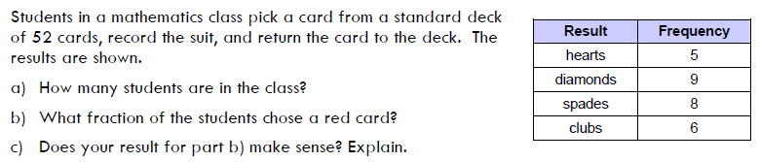
Warm Up
a) 28
b) ½
c) Varies
Packet signatures???

Slide 2
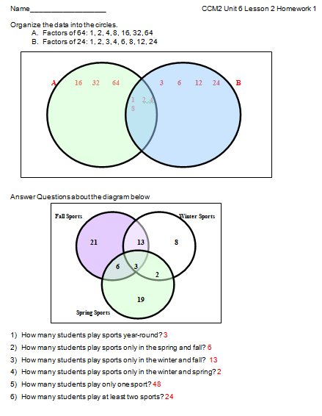
HW Check

Slide 3
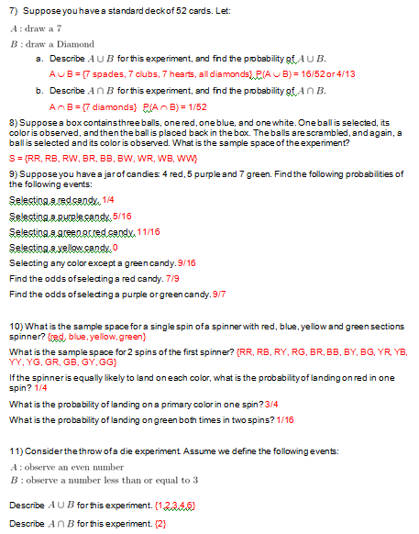
HW Check

Slide 4
Probability of Independent and Dependent Events
OBJ: S-CP.2 Understand that two events A and B are independent if the probability of A and B occurring together is the product of their probabilities, and use this characterization to determine if they are independent.

Slide 5
Independent and Dependent Events
Independent Events: two events are said to be independent when one event has no affect on the probability of the other event occurring.
Dependent Events: two events are dependent if the outcome or probability of the first event affects the outcome or probability of the second.

Slide 6
Independent Events
Suppose a die is rolled and then a coin is tossed.
Explain why these events are independent.
    They are independent because the outcome of rolling a die does not affect the outcome of tossing a coin, and vice versa.
We can construct a table to describe the sample space and probabilities:
 | Roll 1 | Roll 2 | Roll 3 | Roll 4 | Roll 5 | Roll 6
Head
Tail
 | Roll 1 | Roll 2 | Roll 3 | Roll 4 | Roll 5 | Roll 6
Head | 1,H | 2,H | 3,H | 4,H | 5,H | 6,H
Tail | 1,T | 2,T | 3,T | 4,T | 5,T | 6,T

Slide 7
 | Roll 1 | Roll 2 | Roll 3 | Roll 4 | Roll 5 | Roll 6
Head | 1,H | 2,H | 3,H | 4,H | 5,H | 6,H
Tail | 1,T | 2,T | 3,T | 4,T | 5,T | 6,T
How many outcomes are there for rolling the die?
    6 outcomes
How many outcomes are there for tossing the coin?
    2 outcomes
How many outcomes are there in the sample space of rolling the die and tossing the coin?
    12 outcomes

Slide 8
 | Roll 1 | Roll 2 | Roll 3 | Roll 4 | Roll 5 | Roll 6
Head | 1,H | 2,H | 3,H | 4,H | 5,H | 6,H
Tail | 1,T | 2,T | 3,T | 4,T | 5,T | 6,T
Is there another way to decide how many outcomes are in the sample space?
    Multiply the number of outcomes in each event together to get the total number of outcomes.
Let’s see if this works for another situation.

Slide 9
A fast food restaurant offers 5 sandwiches and 3 sides. How many different meals of a sandwich and side can you order?
If our theory holds true, how could we find the number of outcomes in the sample space?
    5 sandwiches x 3 sides = 15 meals
Make a table to see if this is correct.
Were we correct?
    YES!
 | Sand. 1 | Sand. 2 | Sand. 3 | Sand. 4 | Sand. 5
Side 1 | 1,1 | 2,1 | 3,1 | 4,1 | 5,1
Side 2 | 1,2 | 2,2 | 3,2 | 4,2 | 5,2
Side 3 | 3,1 | 3,2 | 3,3 | 3,4 | 3,5

Slide 10
Probabilities of Independent Events
The probability of independent events is the probability of both occurring, denoted by P(A and B) or P(A ∩ B).

Slide 11
 | Roll 1 | Roll 2 | Roll 3 | Roll 4 | Roll 5 | Roll 6
Head | 1,H | 2,H | 3,H | 4,H | 5,H | 6,H
Tail | 1,T | 2,T | 3,T | 4,T | 5,T | 6,T
Use the table to find the following probabilities:
1. P(rolling a 3)
2/12 = 1/6
2. P(Tails)
6/12 = ½
3. P(rolling a 3 AND getting tails)
1/12
4. P(rolling an even)
6/12 = ½
5. P(heads)
6/12 = ½
6. P(rolling an even AND getting heads)
3/12 or 1/4
What do you notice about the answers to 3 and 6?
We can find the answer to 3 by multiplying the probabilities from 1 and 2. We can find the answer to 6 by multiplying the probabilities from 4 and 5.
Notes:
We can find the answer to 3 by multiplying the probabilities from 1 and 2. We can find the answer to 6 by multiplying the probabilities from 4 and 5.

Slide 12
Multiplication Rule of Probability
The probability of two independent events occurring can be found by the following formula:
P(A ∩ B) = P(A) x P(B)

Slide 13
Examples
At City High School, 30% of students have part-time jobs and 25% of students are on the honor roll. What is the probability that a student chosen at random has a part-time job and is on the honor roll? Write your answer in context.
  P(PT job and honor roll) = P(PT job) x P(honor roll) = .30 x .25 = .075
  There is a 7.5% probability that a student chosen at random will have a part-time job and be on the honor roll.

Slide 14
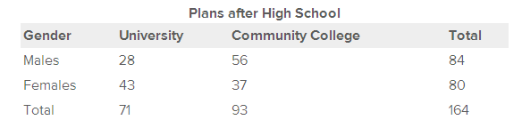
2. The following table represents data collected from a grade 12 class in DEF High School.
Suppose 1 student was chosen at random from the grade 12 class.
(a) What is the probability that the student is female?
(b) What is the probability that the student is going to university?
Now suppose 2 people both randomly chose 1 student from the grade 12 class. Assume that it's possible for them to choose the same student.
(c) What is the probability that the first person chooses a student who is female and the second person chooses a student who is going to university?
80/164 = 20/41
or .488
71/64
80/164 x 71/164 = 355/1681 or .211
Notes:
(a) 80/164 = 20/41 or .488 (b) 71/164 (c) 80/164 x 71/164 = 355/1681 or .211

Slide 15
3. Suppose a card is chosen at random from a deck of cards, replaced, and then a second card is chosen.
Would these events be independent? How do we know?
    Yes, because the first card is replaced before the second card is drawn.
What is the probability that both cards are 7s?
    P(7) = 4/52, so P(7 and 7) = P(7) x P(7) = 4/52 x 4/52 = 1/169 or .0059.
    This means that the probability of drawing a 7, replacing the card and then drawing another 7 is 0.59%

Slide 16
Dependent Events
Remember, we said earlier that
    Dependent Events: two events are dependent if the outcome or probability of the first event affects the outcome or probability of the second.
Let’s look at some scenarios and determine whether the events are independent or dependent.

Slide 17
Determine whether the events are independent or dependent:
Selecting a marble from a container and selecting a jack from a deck of cards.
    Independent
Rolling a number less than 4 on a die and rolling a number that is even on a second die.
    Independent
Choosing a jack from a deck of cards and choosing another jack, without replacement.
    Dependent
Winning a hockey game and scoring a goal.
    Dependent

Slide 18
Probabilities of Dependent Events
We cannot use the multiplication rule for finding probabilities of dependent events because the one event affects the probability of the other event occurring.
Instead, we need to think about how the occurrence of one event will effect the sample space of the second event to determine the probability of the second event occurring.
Then we can multiply the new probabilities.

Slide 19
Examples
Suppose a card is chosen at random from a deck, the card is NOT replaced, and then a second card is chosen from the same deck. What is the probability that both will be 7s?
    This is similar the earlier example, but these events are dependent? How do we know?
      It depends on a card being removed AND not replaced
    How does the first event affect the sample space of the second event?
      Reduces it by 1.

Slide 20
Suppose a card is chosen at random from a deck, the card is NOT replaced, and then a second card is chosen from the same deck. What is the probability that both will be 7s?
Let’s break down what is going on in this problem:
    We want the probability that the first card is a 7, or P(1st is 7), and the probability that the second card is a 7, or P(2nd is 7).
    P(1st is 7) = 4/52 because there a four 7s and 52 cards
    How is P(2nd is 7) changed by the first card being a 7?
    P(2nd is 7) = 3/51
    P(1st is 7, 2nd is 7) = 4/52 x 3/51 = 1/221 or .0045
    The probability of drawing two sevens without replacement is 0.45%

Slide 21
2. A box contains 5 red marbles and 5 purple marbles. What is the probability of drawing 2 purple marbles and 1 red marble in succession without replacement?
    P(1st purple) = 5/10
    P(2nd purple) = 4/9
    P(3rd red) = 5/8
    P(purple,purple,red) = 5/10 x 4/9 x 5/8 = 5/36 or .139
    The probability of drawing a purple, a purple, then a red without replacement is 13.9%

Slide 22
3. In Example 2, what is the probability of first drawing all 5 red marbles in succession and then drawing all 5 purple marbles in succession without replacement?
    P(5 red then 5 purple) = (5/10)(4/9)(3/8)(2/7)(1/6)(5/5)(4/4)(3/3)(2/2)(1/1) = 1/252 or .004
    The probability of drawing 5 red then 5 purple without replacement is 0.4%
    Explain why the last 5 probabilities above were all equivalent to 1.
    This is because there were only purple marbles left, so the probability for drawing a purple marble was 1.

Slide 23
Classwork:
Independent vs Dependent Notes
Homework:
Unit 6 Lesson 1 HW 2
QUIZ THURSDAY!!!

