Slide 1
Power Functions
Lesson 9.1

Slide 2
Power Function
Definition
  Where k and p
  are constants
Power functions are seen when dealing with areas and volumes
Power functions also show up in gravitation (falling bodies)

Slide 3
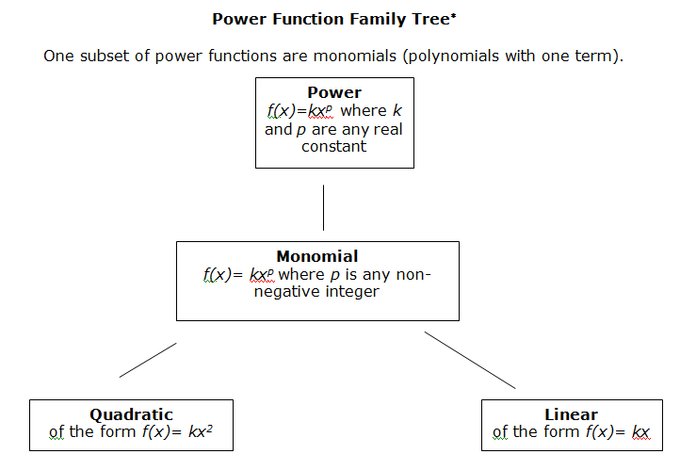

Slide 4
Direct Proportions
The variable y is directly proportional to x when:
y = k * x
  (k is some constant value)
Alternatively
As x gets larger, y must also get larger
  keeps the resulting k the same
This is a power function

Slide 5
Direct Proportions
Example:
  The harder you hit the baseball
  The farther it travels
Distance hit is directly
proportional to the
force of the hit

Slide 6
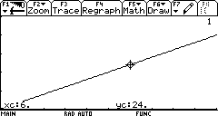
Direct Proportion
Suppose the constant of proportionality is 4
  Then y = 4 * x
  What does the graph of this function look like?

Slide 7
Inverse Proportion
The variable y is inversely proportional
to x when
Alternatively
y = k * x ⁻¹
As x gets larger, y must get smaller to keep the resulting k the same
Again, this is a power function

Slide 8

Inverse Proportion
Example:
If you bake cookies
at a higher
temperature,
they take less time
Time is inversely proportional to temperature

Slide 9
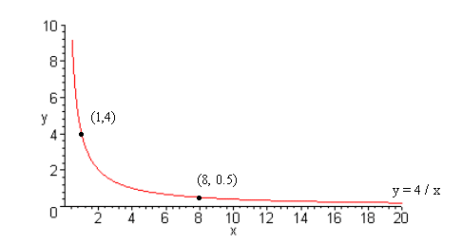
Inverse Proportion
Consider what the graph looks like
  Let the constant or proportionality k = 4
  Then

Slide 10
Power Function
Looking at the
definition
Recall from the chapter on shifting and stretching, what effect the k will have?
  Vertical stretch or compression
for k < 1

Slide 11
Special Power Functions
Parabola y = x²
Cubic function y = x³
Hyperbola y = x⁻¹
(or y = 1/x)

Slide 12
Special Power Functions
y = x⁻²

Slide 13
Special Power Functions
Most power functions are similar to one of these six
x^{p} with even powers of p are similar to x²
x^{p} with negative odd powers of p are similar to x ⁻¹
x^{p} with negative even powers of p are similar to x ⁻²
Which of the functions have symmetry?
  What kind of symmetry?
Symmetry? Type of Symmetry
x² Yes Reflectional
x⁻¹ Yes Rotational
x⁻² Yes Reflectional

Slide 14
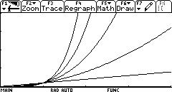
Variations for Different Powers of p
For large x, large powers of x dominate
x⁵
x⁴
x³
x²
x

Slide 15
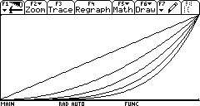
Variations for Different Powers of p
For 0 < x < 1, small powers of x dominate
x
x⁴
x⁵
x²
x³

Slide 16
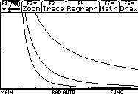
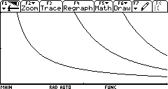
Variations for Different Powers of p
Note asymptotic behavior of y = x ⁻³ is more extreme
0.5
20
10
0.5
y = x ⁻³ approaches x-axis
more rapidly
y = x ⁻³ climbs faster
near the y-axis

Slide 17
Think About It…
x=All Real Numbers except x=0
If Odd, y>0
If Even, y=All Real Numbers except y=0
Given y = x ^{–p} for p a positive integer
What is the domain/range of the function?
  Does it make a difference if p is odd or even?
What symmetries are exhibited?
What happens when x approaches 0
What happens for large positive/negative values of x?
Domain – No
Range – Yes, can not be negative
Even – Reflectional
Odd - Rotational
y gets larger
y gets closer to zero

Slide 18
Formulas for Power Functions
Say that we are told that
f(1) = 7 and f(3)=56
  We can find f(x) when linear y = mx + b
  We can find f(x) when it is y = a(b)^{t}
Now we consider finding f(x) = k x^{p}
  Write two equations we know
  Determine k
  Solve for p
Work manually to demonstrate
k=7
p=1.89

Slide 19
The Data
Use the data below to explore Power Functions with a TI-83+
Age | Length | Weight |  | Age | Length | Weight
1 | 5.2 | 2 |  | 11 | 28.2 | 318
2 | 8.5 | 8 |  | 12 | 29.6 | 371
3 | 11.5 | 21 |  | 13 | 30.8 | 455
4 | 14.3 | 38 |  | 14 | 32.0 | 504
5 | 16.8 | 69 |  | 15 | 33.0 | 518
6 | 19.2 | 117 |  | 16 | 34.0 | 537
7 | 21.3 | 148 |  | 17 | 34.9 | 651
8 | 23.3 | 190 |  | 18 | 36.4 | 719
9 | 25.0 | 264 |  | 19 | 37.1 | 726
10 | 26.7 | 293 |  | 20 | 37.7 | 810

Slide 20
